Slide 1
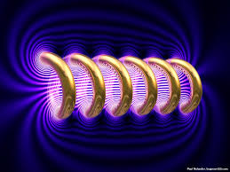
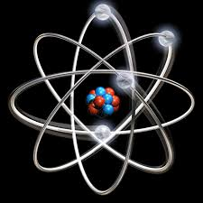

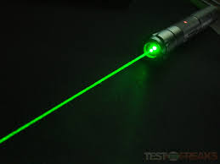
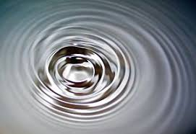
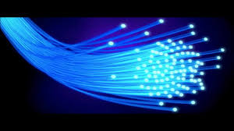
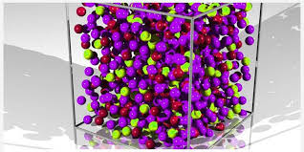
Engineering Physics
PHY-109
FO-4
ELECTROMAGNETIC THEORY
QUANTUM MECHANICS
LASER
WAVES
Dr. Vishal Thakur
Department of Physics
Lovely Professional University
Phagwara, Punjab-144411
SOLID STATE PHYSICS
FIBER OPTICS

Slide 2
Syllabus
Fiber optics introduction, optical fiber as a dielectric wave guide (Discussion + Video)
Total internal reflection, acceptance angle, numerical aperture, relative refractive index, V-Number
Step index and graded index fibers
losses associated with optical fibers
Applications of optical fibers

Slide 3
Losses Associated with Optical Fibers
The losses in optical fibers may be due to the following causes:
Rayleigh Scattering Losses
Absorption Losses
Microbend Losses
Macrobend Losses

Slide 4
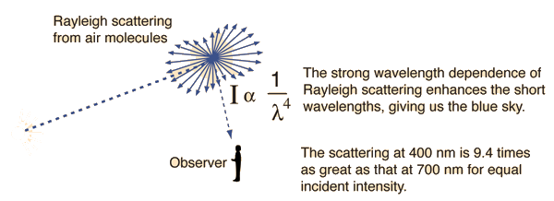
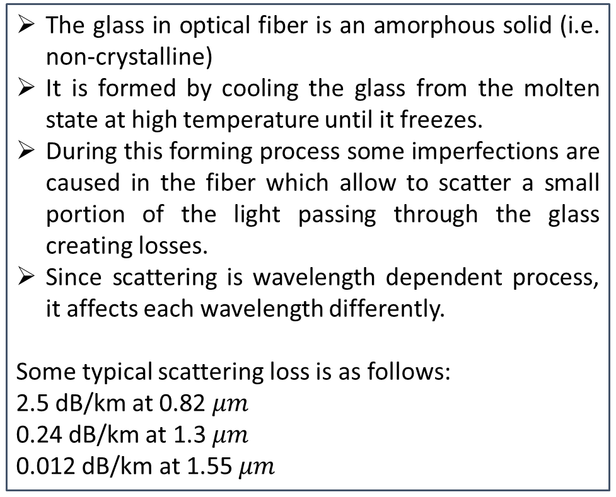
Rayleigh Scattering Loss
The glass in optical fiber is an amorphous solid (i.e. non-crystalline)
It is formed by cooling the glass from the molten state at high temperature until it freezes.
During this forming process some imperfections are caused in the fiber which allow to scatter a small portion of the light passing through the glass creating losses.
Since scattering is wavelength dependent process, it affects each wavelength differently.
Some typical scattering loss is as follows:
2.5 dB/km at 0.82 $μm$
0.24 dB/km at 1.3 $μm$
0.012 dB/km at 1.55 $μm$
Rayleigh Scattering
Rayleigh scattering, named after the British physicist Lord Rayleigh is the elastic scattering of light or other electromagnetic radiation by particles much smaller than the wavelength of the radiation.
The cause of scattering can be a particle, a density anomaly or even a surface anomaly.
http://www.differencebetween.com/difference-between-scattering-and-vs-reflection/

Slide 5
Absorption Losses
Three mechanism contribute to the absorption loss
Ultraviolet absorption
Infrared absorption
Ion resonance absorption.
The oxygen ions in pure silica have very tightly bonded electrons and only the ultraviolet light photons have enough energy to be absorbed. However in silica light guide, the dopants and transitional metal impurities have electrons that can be excited in the visible and near infrared light regions.
Infrared absorption takes place because photons of light energy are absorbed by atoms within the glass molecules and converted to the random mechanical vibration type of heating.
During manufacture some minute quantities of water molecules trapped in the glass contribute hydroxyl ions (OH-) to the material. These ions also absorb energy at peaks of 0.95, 1.23 and 1.3 micro meter with main peak at 1.39 micrometer.

Slide 6
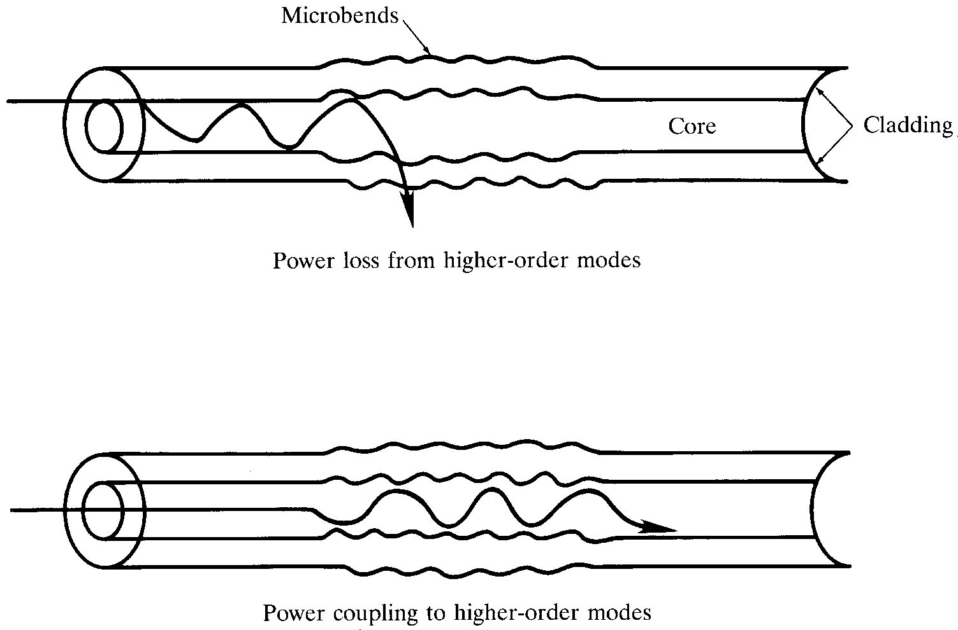
Micro bending Losses
Microbend loss is a loss due to small surface irregularities in the cladding. This causes light to be reflected at angles where there is no further reflection.

Slide 7
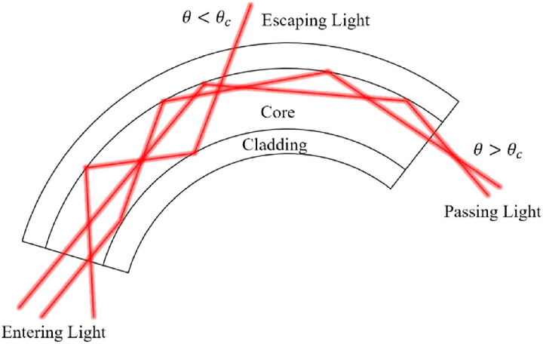
Macro bending Losses
Macrobend is a bend in the entire cable which causes certain modes not to be reflected and therefore causes loss to the cladding.

Slide 8
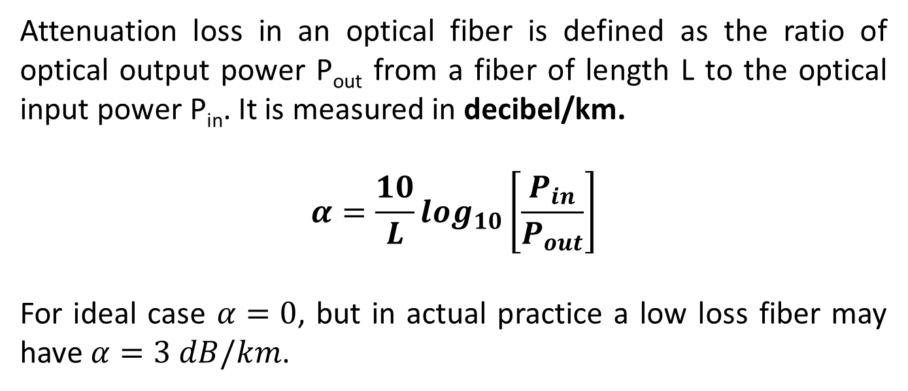
Attenuation
Attenuation loss in an optical fiber is defined as the ratio of optical output power P_{out} from a fiber of length L to the optical input power P_{in}. It is measured in decibel/km.
$$α=\frac{10}{L}log_{10}\left[\frac{P_{in}}{P_{out}}\right]$$
For ideal case $α=0$, but in actual practice a low loss fiber may have $α=3 dB/km$.

Slide 9
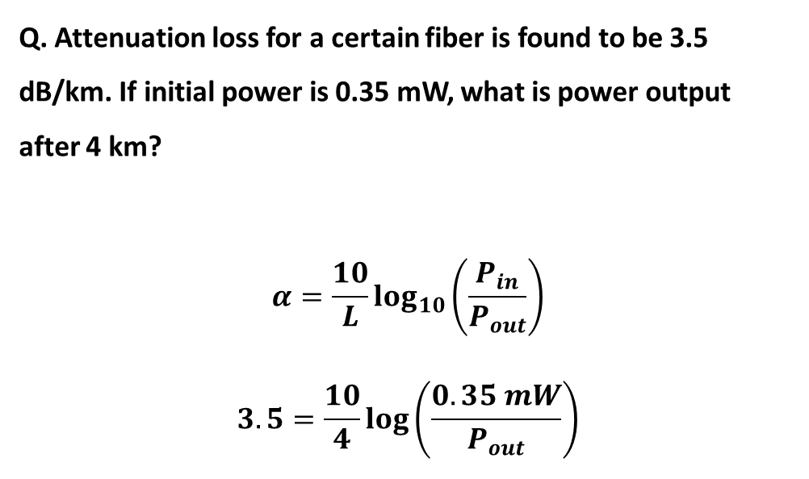
Attenuation
Q. Attenuation loss for a certain fiber is found to be 3.5 dB/km. If initial power is 0.35 mW, what is power output after 4 km?
$$α=\frac{10}{L}log_{10}\left(\frac{P_{in}}{P_{out}}\right)$$
$$3.5=\frac{10}{4}\log\left(\frac{0.35 mW}{P_{out}}\right)$$

Slide 10
Applications of Fiber Optics
Wide range application is there in the field of communication as information channels.
In military mobiles such as air-craft, ships, tanks etc., fiber guided missiles, short and long distance communication links.
Close circuit TV (CCTV) links for traffic controls and security.
In ophthalmology, a laser beam guided by fibers is used to reattach detached retinas and to correct defects in vision.
In endoscopy for visualization of internal portions of the human body.
In sensors and transducers.
In the signal multiplexing.

